Slide 1

Infosys Budget Wise AI based Expense Forecasting Tool
Integrates predictive analytics with real-time data to deliver accurate, adaptive forecasts that improve financial decision-making

Slide 2
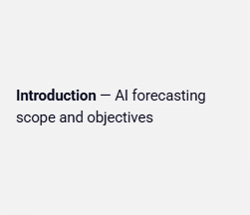
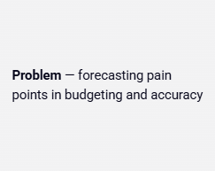
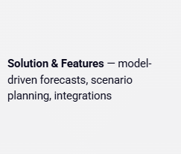
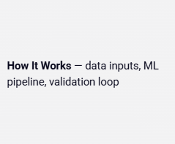
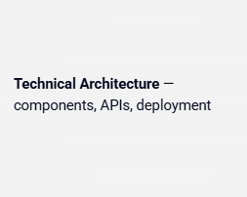
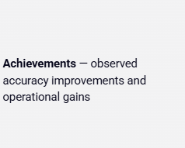
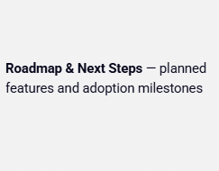
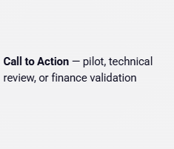
AI Budget Forecasting Tool — Presentation Overview
Concise roadmap covering purpose, features, architecture, results, and next steps for finance and engineering audiences

Slide 3





Introduction to AI Budget Forecasting
Use machine learning on historical and real-time data to improve budgeting, reduce risk, and enable strategic decisions
Predictive accuracy from ML models analyzing large volumes of historical and real-time data
Dynamic adaptation: models update forecasts as new data arrives
Risk mitigation through pattern detection and anomaly alerts
Informed strategic planning with scenario simulation and resource allocation insights
More reliable budgeting versus static models via continuous analytics

Slide 4

Project Statement: Personal Budgeting & Expense Forecaster
Many people struggle with personal finance due to overwhelming daily transactions, making it hard to track spending, stick to budgets, and plan for the future. This lack of financial clarity causes stress, lost savings, and hinders long-term stability. The "Personal Budgeting & Expense Forecaster" aims to solve this by providing an intuitive tool that uses time-series forecasting on historical (simulated) transaction data. This will help users visualize spending patterns, set financial goals, and predict future expenses and savings, ultimately enabling them to make better financial decisions and gain control over their finances.

Slide 5
Proposed Solution:
The BudgetWise AI-Based Expense Forecasting Tool is an intelligent Streamlit web application designed to help individuals proactively manage their finances and overcome common budgeting challenges.
The solution integrates a powerful set of features:
Effortless Data Ingestion & Smart Categorization: Users can easily input transactions manually or via CSV uploads, which are then automatically categorized using a rule-based NLTK engine, streamlining the initial data organization.
Comprehensive Financial Tracking & Analytics: All financial data is securely stored in an SQLite database, forming the basis for Pandas-driven analytics that provide real-time spending summaries, income/expense reports, and clear trend visualizations.
Predictive AI Forecasting: At its core, BudgetWise leverages Meta's Prophet library to intelligently forecast future expenses and spending patterns based on historical data, offering users crucial foresight for financial planning.
Interactive Dashboards & Goal Management: An intuitive dashboard, built with Streamlit and Altair, provides dynamic visualizations of financial health, future forecasts, and allows users to set and track personal financial goals with clear progress indicators and alerts.
Admin Configurability: An Admin Dashboard empowers customization by allowing dynamic management of transaction categories and their associated keyword rules, ensuring the system remains adaptable and relevant.

Slide 6
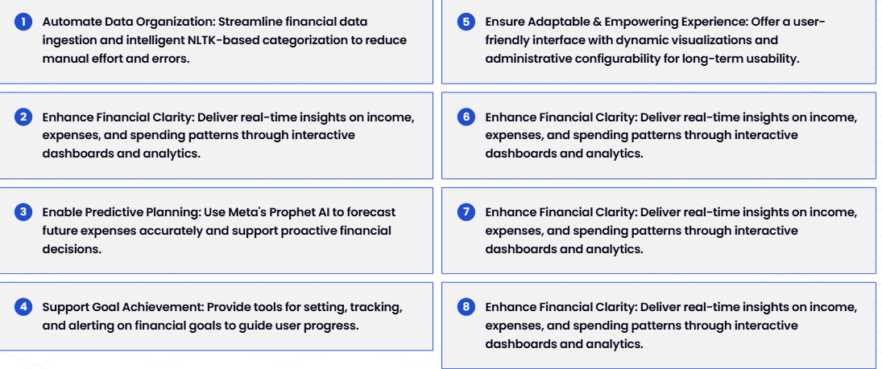
Objectives
Core objectives of the BudgetWise AI-Based Expense Forecasting Tool

Slide 7
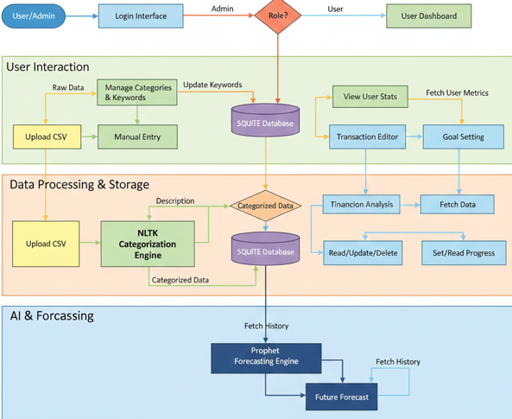
Process Flow Diagram

Slide 8
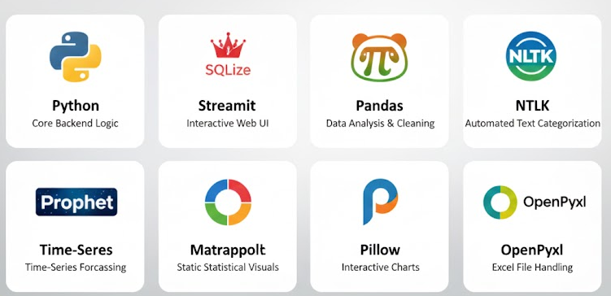
Technologies Used

Slide 9
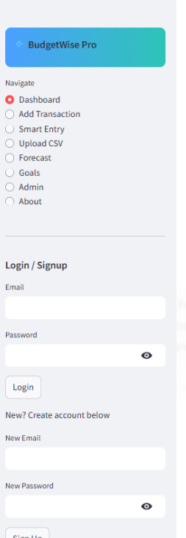
MILESTONE 1: Foundation & Basic Input
Implemented a mock User Authentication system for login/signup, utilizing st.session_state to simulate user sessions.
Developed a minimal Profile Management setup, using the session state for basic user identification.
Created a user-friendly Manual Transaction Input form, capturing essential transaction details and storing them in-memory (st.session_state) for the current session.

Slide 10
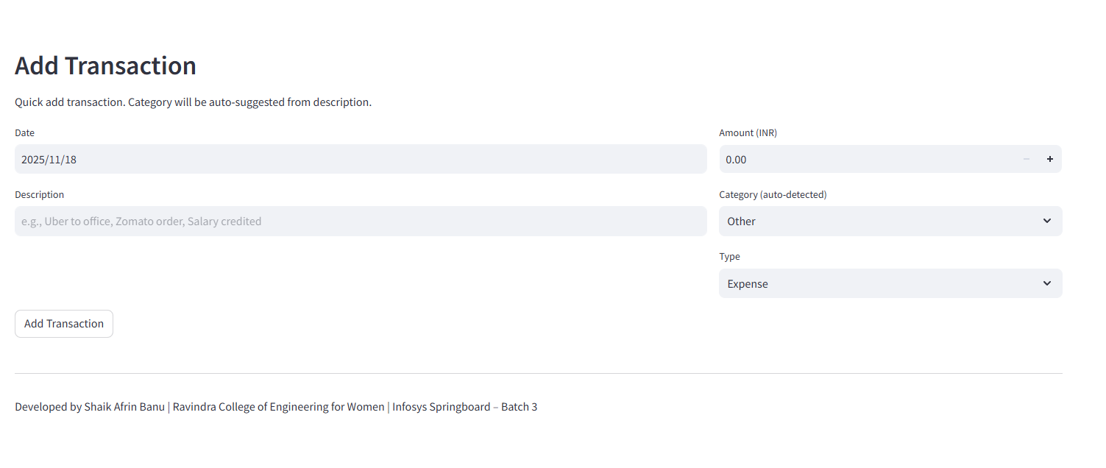
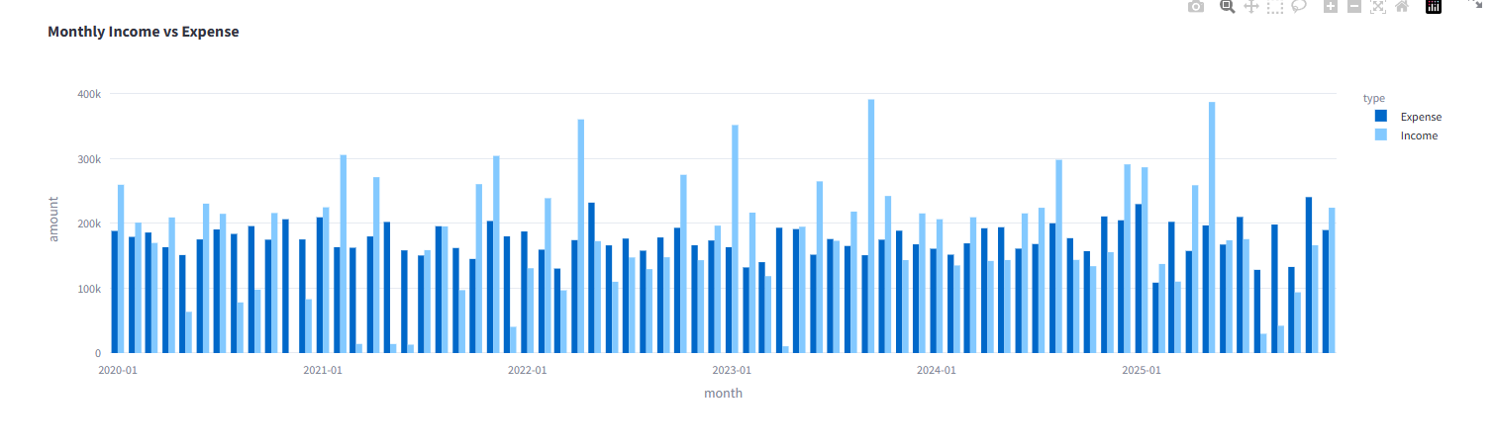
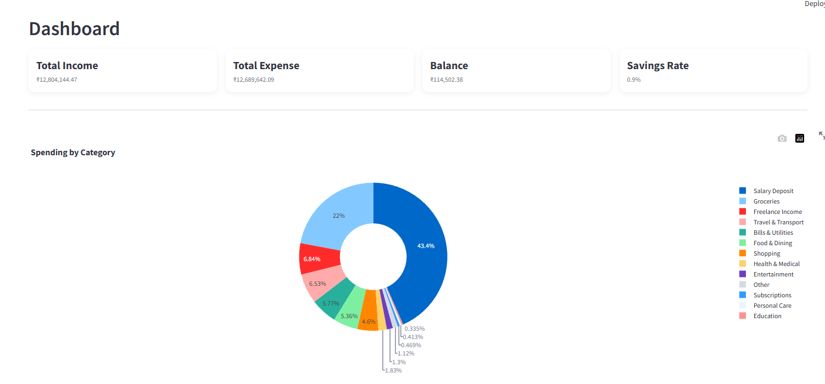
MILESTONE 2: Data Processing, Analysis & Visualization
Integrated Automated Transaction Categorization using a rule-based NLTK engine, efficiently classifying transactions from descriptions.
Developed Comprehensive Spending Summary Reports & Analysis with Pandas, providing insights into income vs. expense, monthly spending, and category breakdowns.
Implemented an interactive Dashboard View featuring key financial metrics, a dynamic pie chart for category spending, and a detailed transaction table.

Slide 11
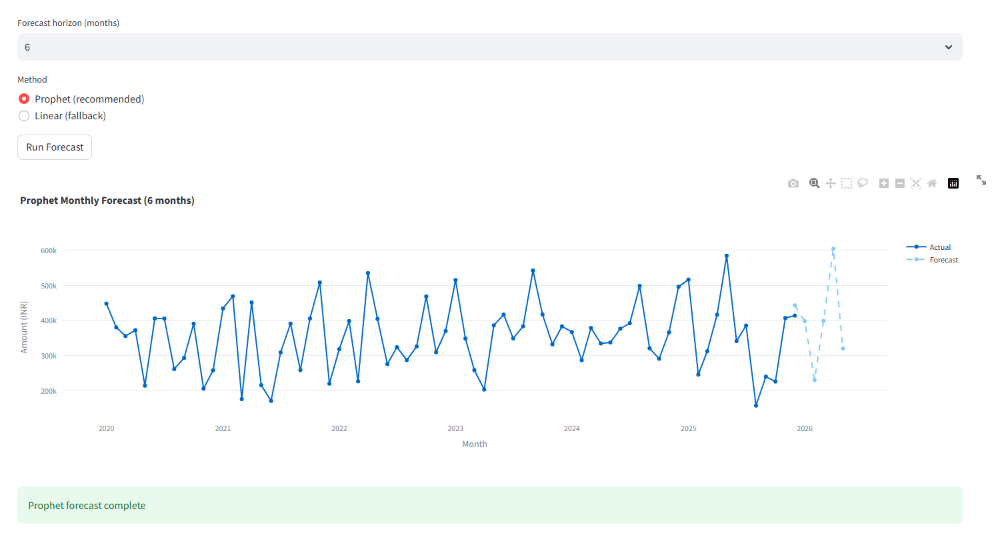
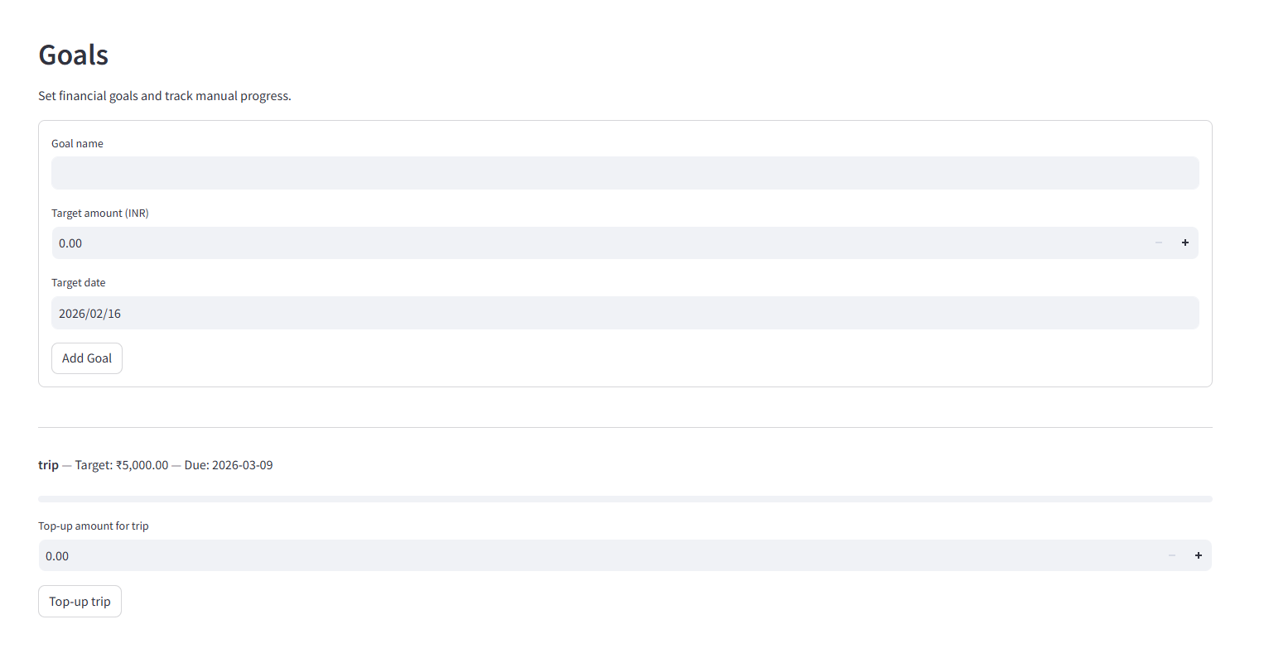
MILESTONE 3: Forecasting Engine & Initial Goal Setting
Prepared Historical Data by aggregating transactions into a time-series format (ds, y) suitable for predictive modeling.
Successfully Integrated Meta's Prophet library, training the model with customized seasonality (weekly, yearly) to generate future expense forecasts.
Developed Interactive Forecast Visualizations (Altair), displaying future predictions, confidence intervals, and component breakdowns (trend, seasonality) alongside historical data.
Laid the initial framework for Financial Goal Setting, to be fully developed and integrated in the subsequent milestone.

Slide 12
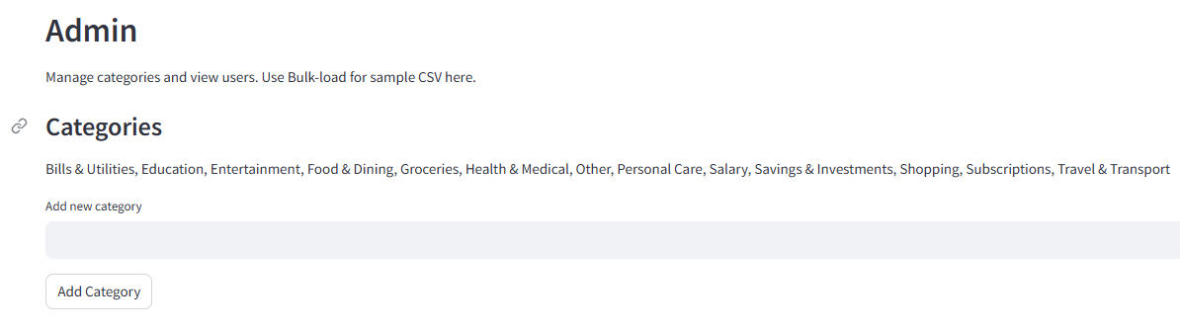
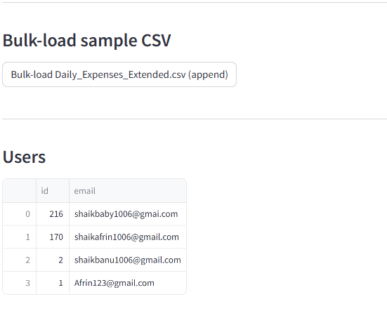
MILESTONE 4: Admin Dashboard & System Management
Implemented Role-Based Access Control (RBAC), differentiating user and admin logins with an "Admin Mode" toggle for secure access.
Developed a dedicated Admin Dashboard for system monitoring, displaying key performance indicators (KPIs) like total users, transactions, and active goals
Enabled Dynamic Category Management, allowing administrators to create, update, and manage transaction categories and their associated keywords via a UI, dynamically updating the NLTK engine.

Slide 13
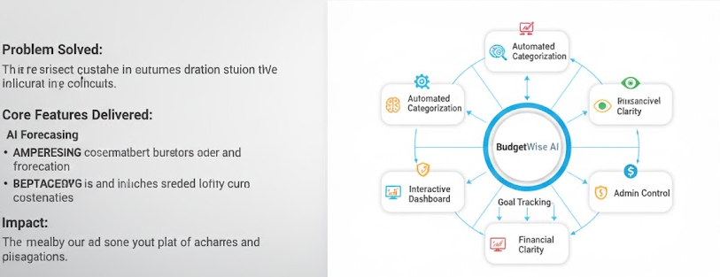
Project Summary & Key Achievements:

Slide 14
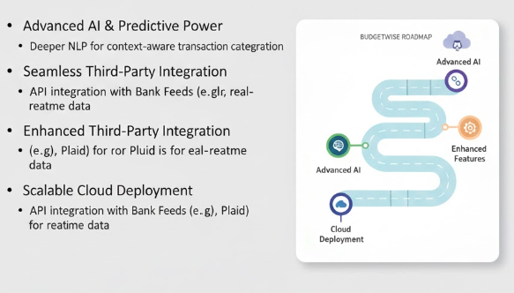
Future Enhancement & Road Map :

Slide 15
CONCLUSION:
BudgetWise: Empowering Your Financial Future
We've demonstrated how BudgetWise transforms complex financial management into an intuitive, AI-driven experience. By automating categorization, providing predictive forecasts, and enabling proactive goal tracking, BudgetWise empowers individuals to gain unparalleled clarity and control over their finances, ensuring smarter decisions and greater financial stability.
Thank You!

